Slide 1
ERM – A Worked Example

Slide 2
Objectives
We will use a simple scenario to:
identify the entities involved
Identify the relationships between the entities (if any)
Identify the multiplicity (or degree)
Determine the optionality of the relationships between entities

Slide 3
To create an E:R Model
You would use the results of your fact finding to identify the entities
In this case we will use a scenario
Identify the entities from the scenario

Slide 4
The Scenario
A small Cinema club runs a number of cinemas throughout the region. Each cinema can show various films at several daily showings over several days/weeks/months depending on the popularity of the film. Members book tickets for a particular showing
Identify the entities

Slide 5
A small Cinema club runs a number of
cinemas throughout the region. Each
cinema can show various films at several
daily showings.
Members book tickets for a particular
Showing.

Slide 6
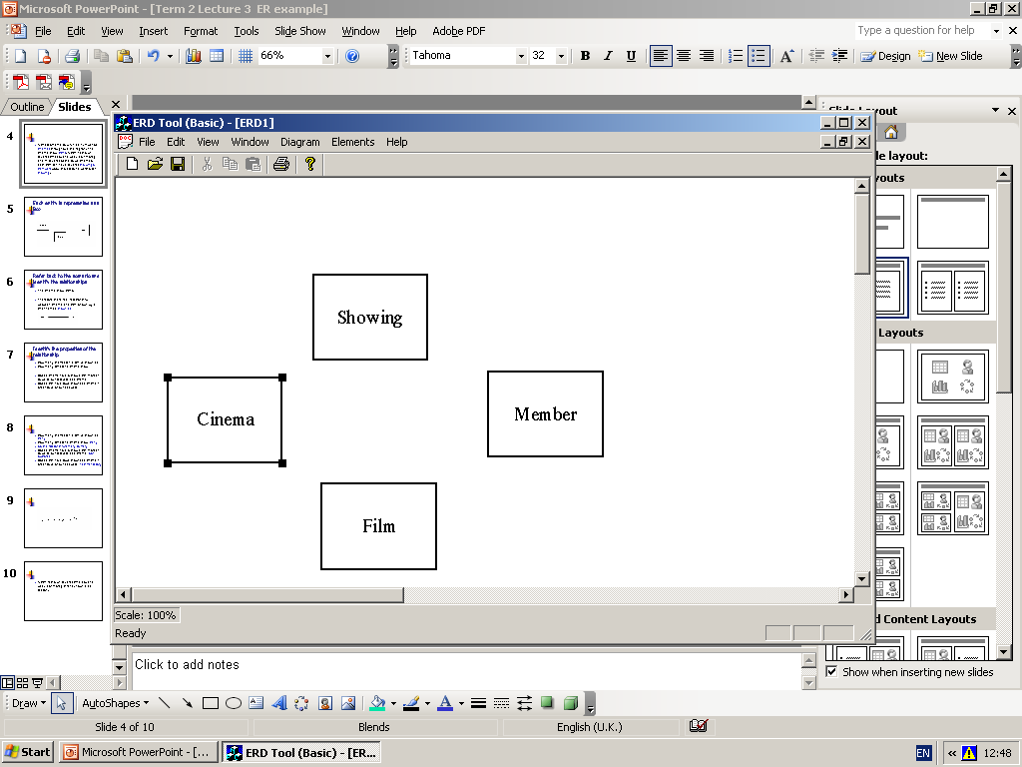
Each entity is represented as a Box

Slide 7
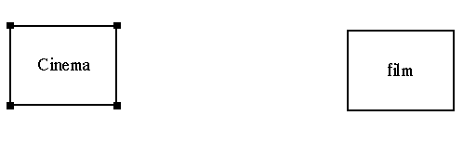
Refer back to the scenario and identify the relationships
The cinema shows films.
Therefore there is a relationship between cinema and film Shown by a line- named shown at

Slide 8
Identify the properties of the relationship
How many cinemas can a film be shown at?
How many films can a cinema show?
Does a cinema have to show a film in order to be on our database as a cinema?
Does a film have to be shown at a cinema in order to be on our database?

Slide 9
How many cinemas can a film be shown at? Many
How many films can a cinema show? Many
So the relationship is many to many
Does a cinema have to show a film in order to be on our database as a cinema? No- optional
Does a film have to be shown at a cinema in order to be on our database? Yes- mandatory

Slide 10
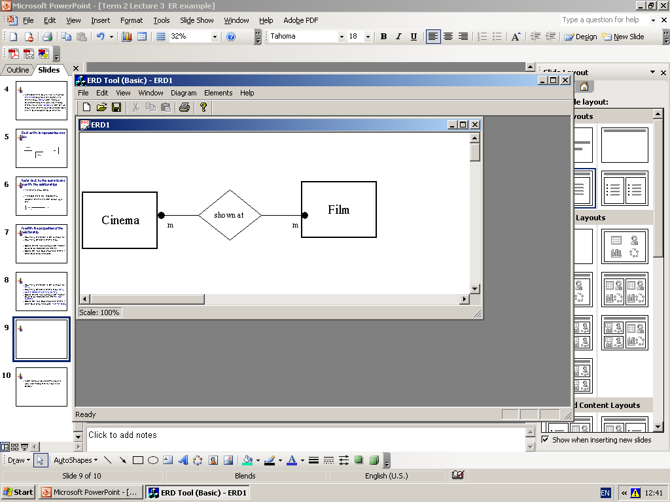

Slide 11
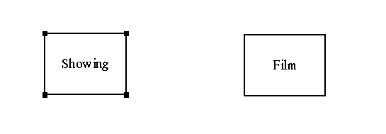
Each cinema can show various films at
several daily showings..

Slide 12
Showing and film
Relationship name-screens
A showing shows how many films?
A film can have how many a showings?
A film must have a showing to be on database?
A showing must have a film to show to be on the database?

Slide 13
A showing shows how many films?
  1
A film can have how many a showings?
  Many
A film must have a showing to be on database?
  Yes-mandatory
A showing must have a film to show to be on the database?
  Yes -Mandatory

Slide 14
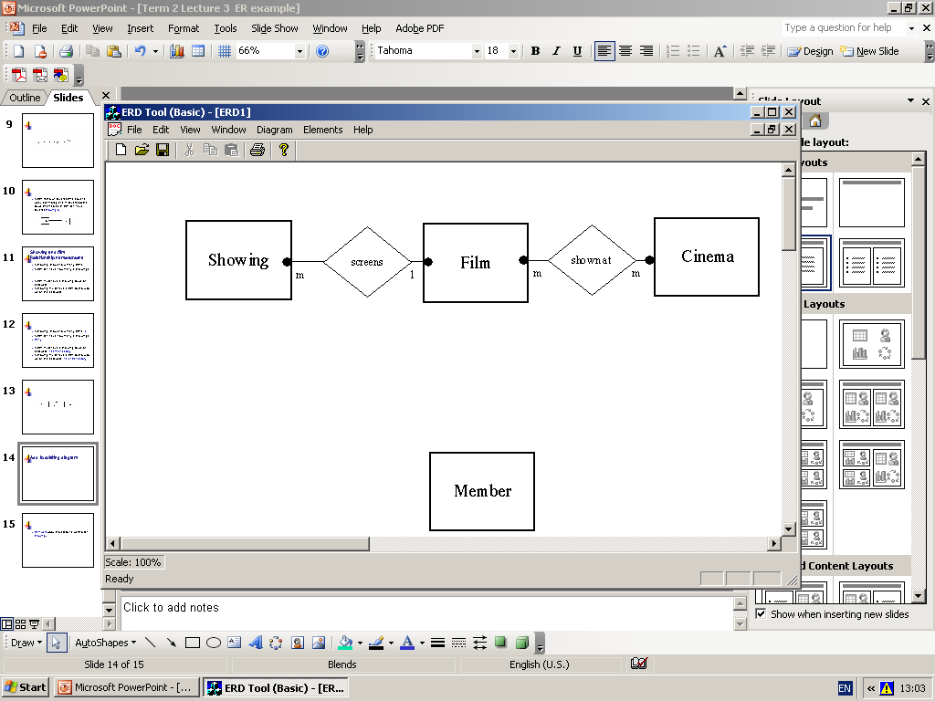

Slide 15
Add to existing diagram

Slide 16
Members book tickets for a particular showing
How many bookings can a member make for a showing?
A Showing has bookings made by how many members?
A showing must have a booking ?
A member must have made a booking?

Slide 17
How many bookings can a member make for a showing?
  many
A Showing has bookings made by how many members?
  many
A showing must have a booking ?
  No- Optional
A member must have made a booking?
  No -optional

Slide 18
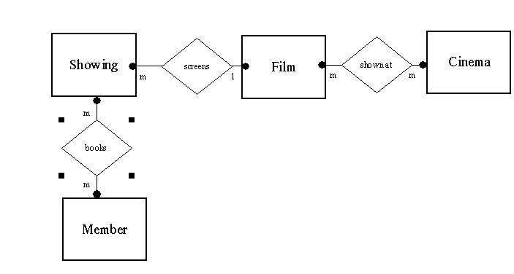
Add to diagram

Slide 19
Important!
The diagram that has been produced contains many to many relationships
Many to many relationships cannot be implemented in a relational database

Slide 20
References
Data Analysis for database Design
By D R Howe

